Slide 1
AUTOMATION TESTING ON FACEBOOK
By:
N Deepak

Slide 2
Introduction
Automation Testing is a software testing technique that performs using special automated testing software tools to execute a test case suite. On the contrary, Manual Testing is performed by a human sitting in front of a computer carefully executing the test steps.
The goal of Automation is to reduce the number of test cases to be run manually and not to eliminate Manual Testing altogether.

Slide 3
Introduction
Test cases to be automated can be selected using the following criterion to increase the automation ROI
High Risk – Business Critical test cases
Test cases that are repeatedly executed
Test Cases that are very tedious or difficult to perform manually
Test Cases which are time-consuming

Slide 4
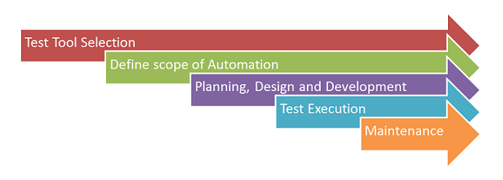
Automated Testing Process

Slide 5
Tools used
Selenium - Selenium is one of the most popular automation testing tools out there and is meant only for web applications. It has automation suites designed for bug reproduction and regression testing and allows for testing across multiple browsers.
TestNG - TestNG in Selenium is a Java testing framework, inspired by JUnit and NUnit. It overcomes the constraints and disadvantages of JUnit. The suffix 'NG' stands for Next Generation, signifying the new functionalities that TestNG brings to the table.

Slide 6
Problem Statement
Our activity mainly focuses on testing the basic features of handling a Social media Account. In this case, we have taken the example of facebook account. This involves logging in and out of our account, verifying the account that we logged into, editing the account details such as profile pic updation, adding or updating personal details, traversing through different tabs and so on.

Slide 7
Objectives of this activity:
To automate the process of logging in and out from our account.
To handle tabs traversal.
To test out the add and update features of the account.

Slide 8
Test Cases

Slide 9
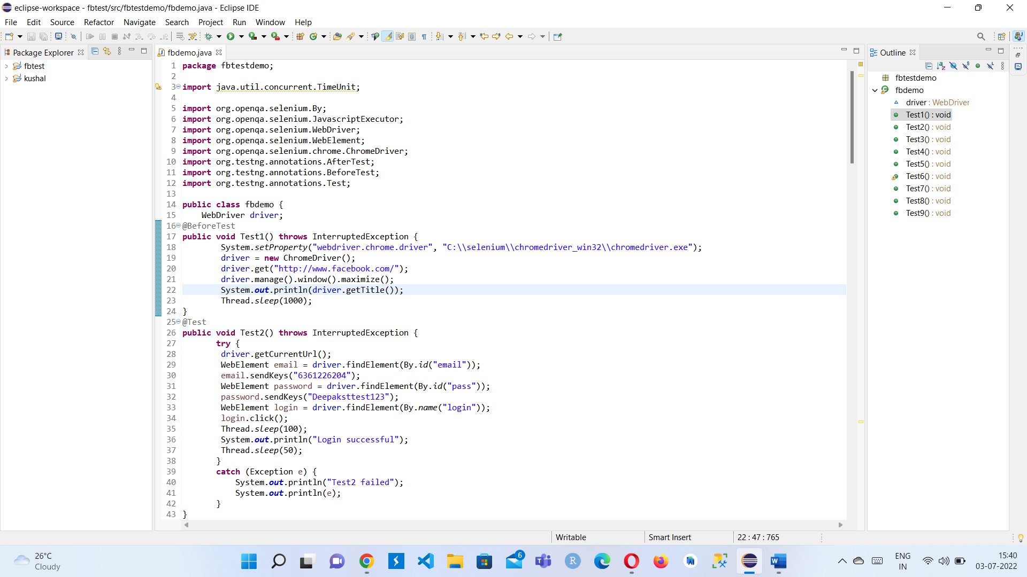
TEST CASE 1 : API testing

Slide 10
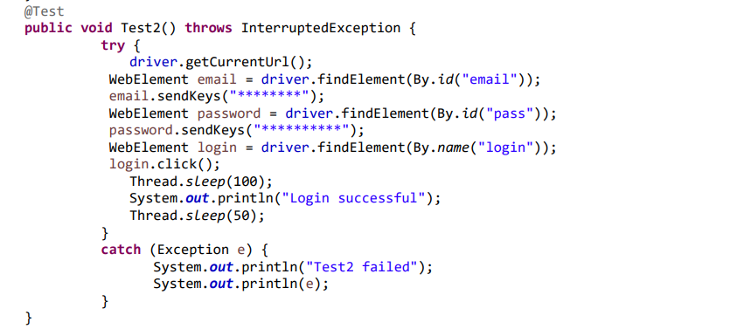
TEST CASE 2 : UI testing

Slide 11
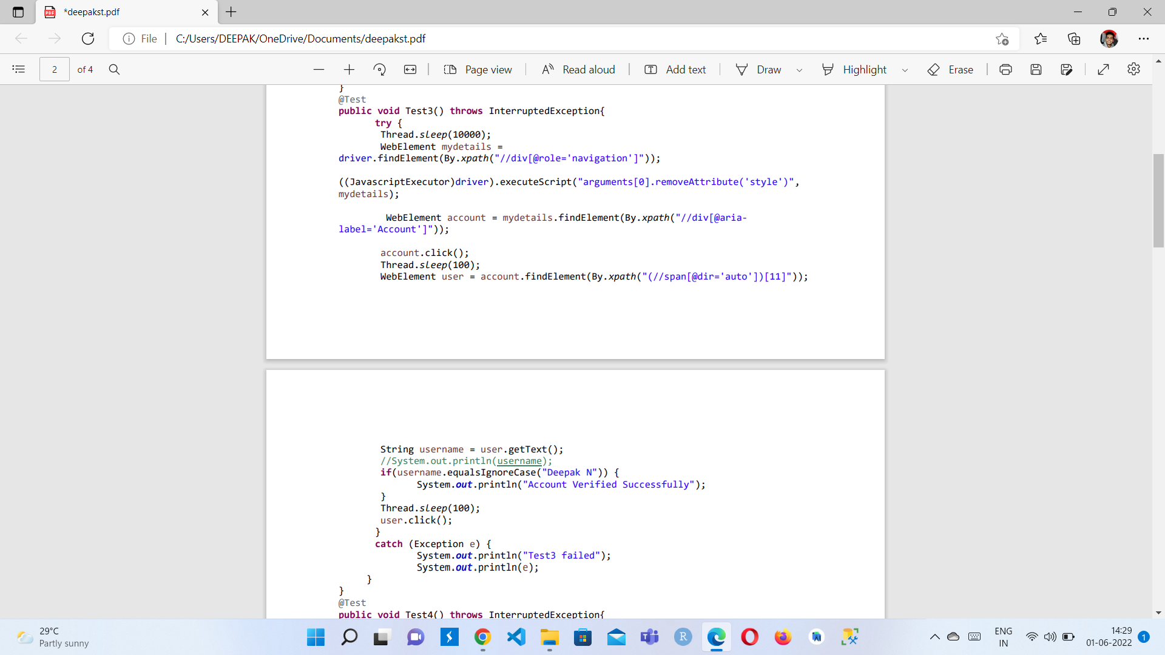
TEST CASE 3 : Unit testing

Slide 13
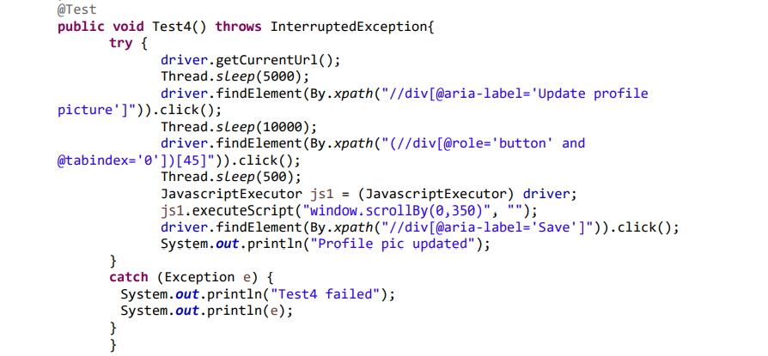
TEST CASE 4 : Smoke testing

Slide 14
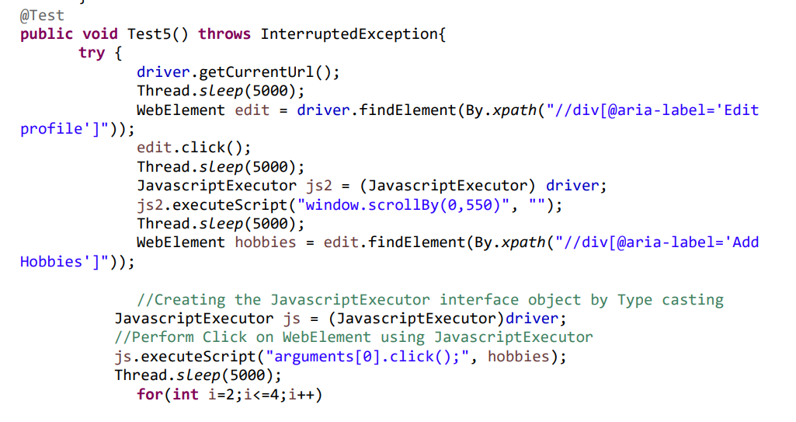
TEST CASE 5 : Integration testing

Slide 15
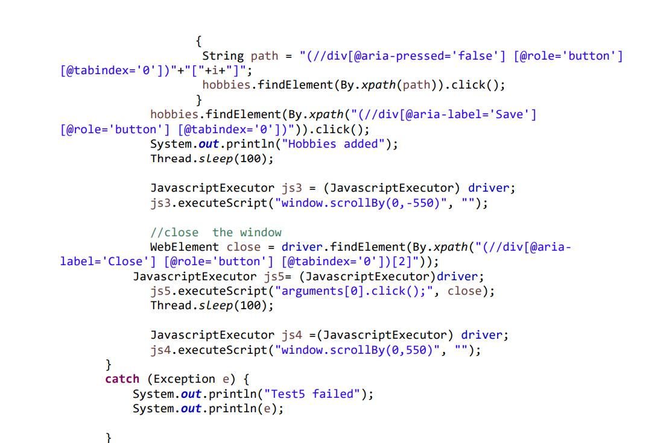

Slide 16
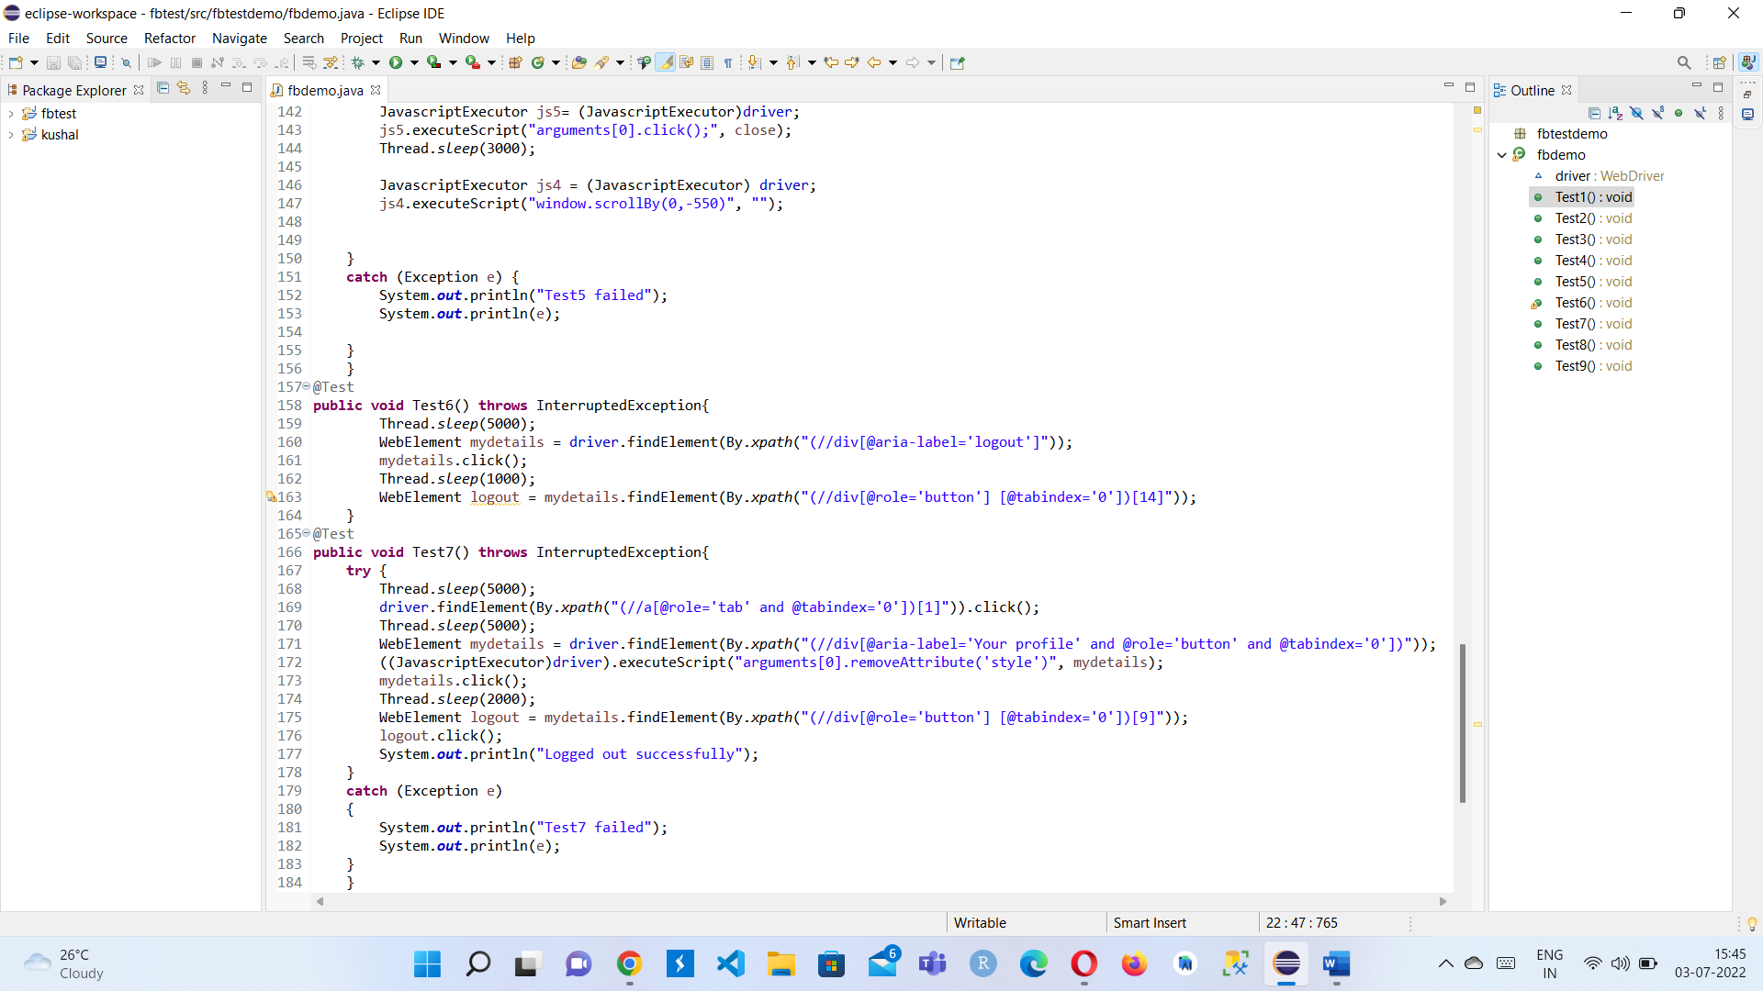
TEST CASE 6 & 7 : Unit testing

Slide 17
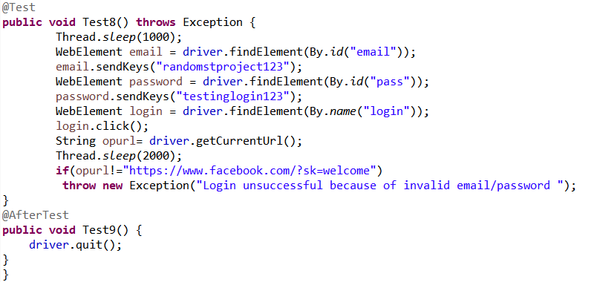
TEST CASE 8 : Security testing

Slide 18
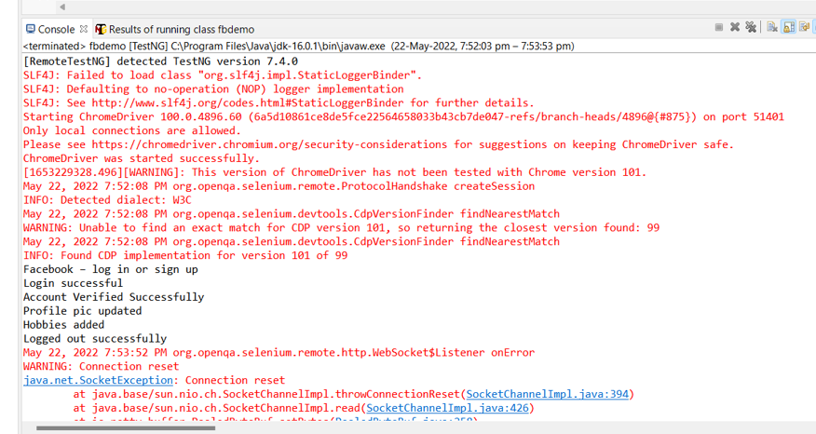
OUTPUT
Pass
Test cases

Slide 19
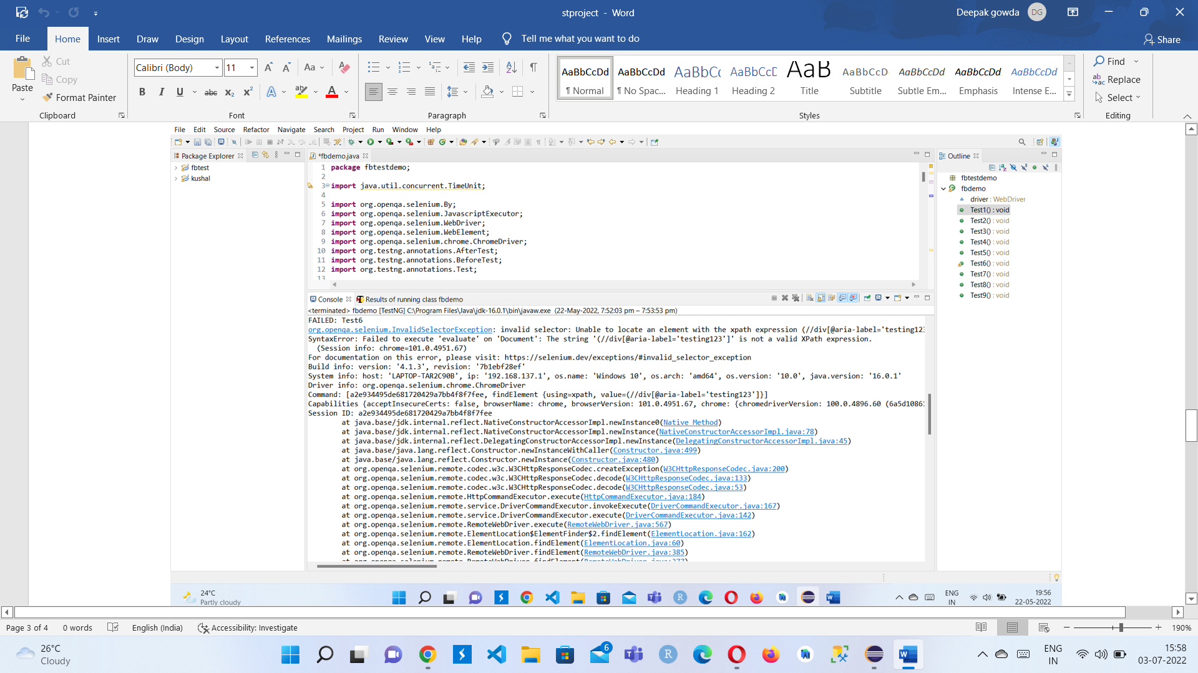
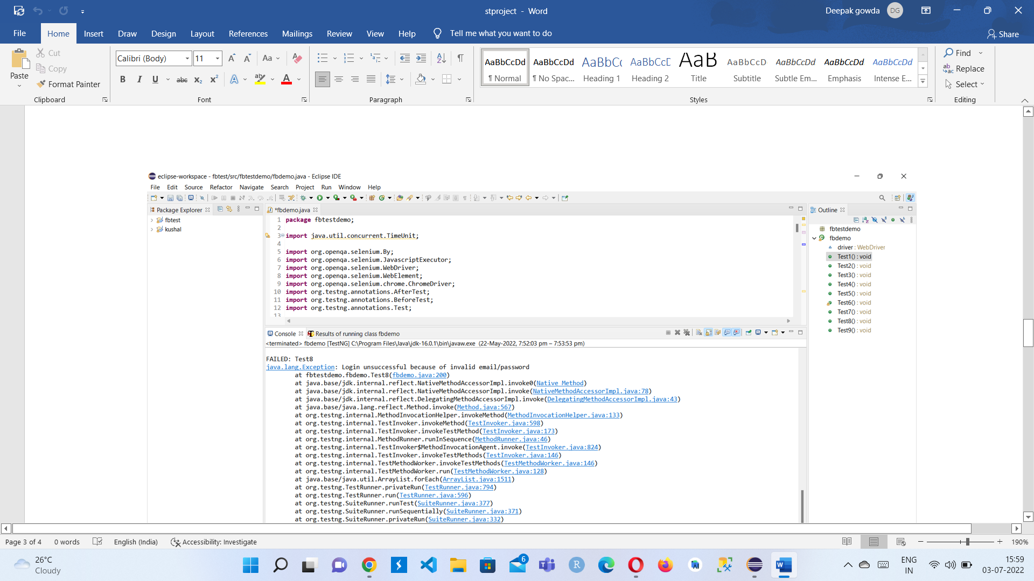
Failed Test cases

